Slide 1
National Information
Exchange Model
(NIEM™)
Enterprise Architect User Group Canberra
15 Apr 2015

Slide 2
About APG
APG’s mission is to
“Align information technology and systems engineering
capabilities with business strategy using proven, practical processes delivering world-class results.”
Industry thought leader in enterprise architecture, business modeling, process improvement, systems and software engineering, requirements management, and agile methods
Member and contributor to
  UML, SysML, SPEM, UPDM at the Object Management Group (OMG)
  TOGAF and ArchiMate at The Open Group
  Eclipse Process Framework (EPF) at the Eclipse Foundation
Business partners with Sparx, HP, and IBM

Slide 3

NIEM History
National Information Exchange Model (NIEM) was initiated in 2005 by U.S. Department of Justice (DOJ) and U.S. Department of Homeland Security (DHS)
  Early design based on Global Justice XML Data Model (GJXDM)
  U.S. Department of Health and Human Services (DHHS) joined in 2010 as third steward
Unite stakeholders from federal, state, local, and tribal governments
  Develop and deploy national model for information sharing and organizational structure for governance
Recognition that widespread adoption and use would require common vocabularies for information sharing
  By 2015, all 50 states and majority of federal agencies are using (or considering using) NIEM
  http://tools.niem.gov/niemtools/iepdt/search/index.iepd
National Information Exchange Model (NIEM) v3.0

Slide 4
NIEM Success Stories
Shared Computer Operations for Protection and Enforcement (SCOPE) II
Nevada Department of Public Safety, Clark County, Las Vegas Metropolitan Police Department, City of Henderson, City of Las Vegas, City of North Las Vegas​
Enables 80 law enforcement and justice agencies at every level of government to share information to provide enhanced 24/7 public safety and justice services
Benefits in time savings are estimated to be $8.3 million per year
North Carolina Families Accessing Services Through Technology (NC FAST) Program
North Carolina Department of Health and Human Services (DHHS)
Enables NC DHHS and 100 county departments to spend less time performing administrative tasks and more time assisting families
Describes services and exchanges that are reusable for other US state social services programs
Tactical Infrastructure Enterprise Services Coalition Warfare Program (TIES CWP)
U.S. Army
Improves interoperability and information sharing between U.S. and coalition partners
  First time this type of information has been exchanged among participants
Introducing NIEM approach to NATO for improving data interoperability among NATO and coalition forces
  Fulfill NATO Federated Mission Networking information sharing requirements
https://www.niem.gov/aboutniem/best-of-niem/
Pages/best-of-niem.aspx

Slide 5
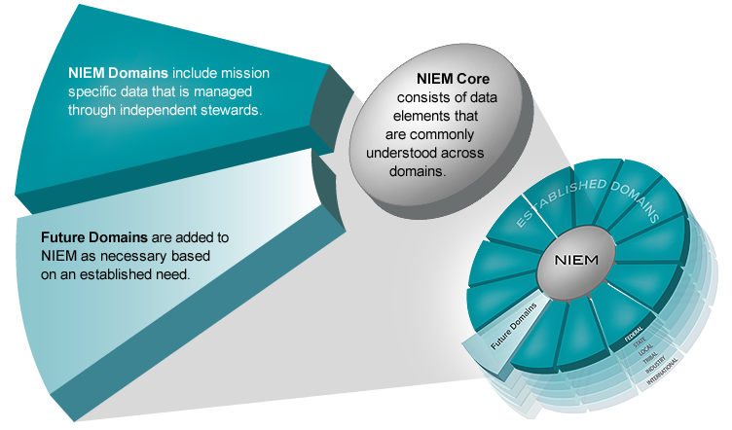
NIEM 3.0 Model and Domains
Existing Domains
Biometrics
CBRN (Chemical, Biological, Radiological, Nuclear)
Children, Youth, and Family Services
Emergency Management
Immigration
Infrastructure Protection
Intelligence
International Trade​​
Justice
Maritime​​
MilOps​​
Screening​
Emerging Domains
Agriculture
Cyber
Government Resources Management (GRM)
Health

Slide 6
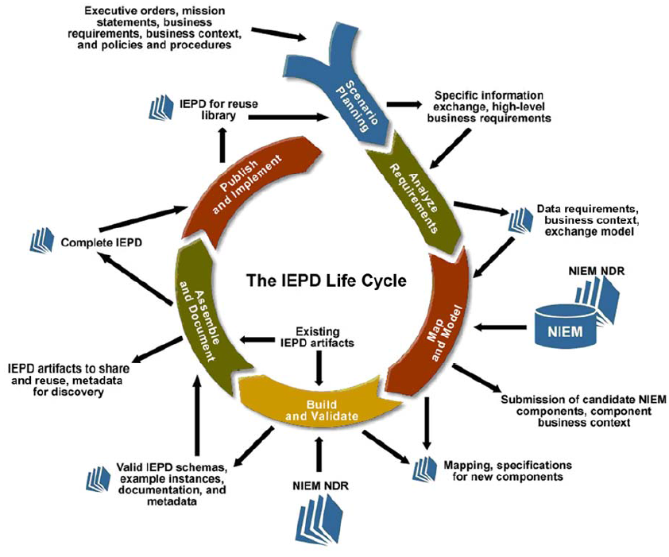
Information Exchange Package Description (IEPD)
Combination of both business and technical content for implementing an information exchange
Scenarios, catalog, change log, conformance assertions
Set of XML schema documents

Slide 7
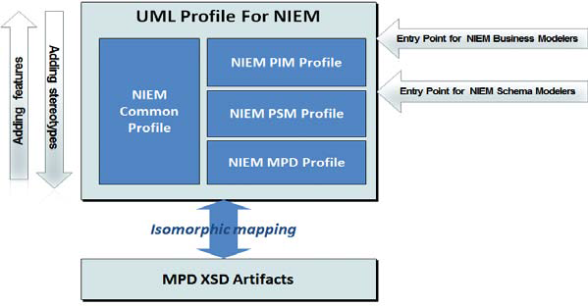
NIEM-UML
OMG specification to enable general use of UML and MDA tools to support development and use of NIEM information exchanges and models
  Build standard UML representations of NIEM information exchanges and models
  Generate associated NIEM-conforming XML schemas and other artifacts
Object Management Group (OMG)
Model Driven Architecture (MDA) v1.0

Slide 8
Enterprise Architect NIEM Demo
Review TOGAF Enterprise Repositories context
Reverse engineer NIEM XSDs
Create Model Package Description (MPD)
Use EA Schema Generator to create NIEM subset
Generate NIEM Information Exchange Package Documentation (IEPD)

Slide 9

Q&A
http://www.aprocessgroup.com
Thanks for your attention
and participation!

